Slide 1

AI Top Goal Scorer Estimator
A high-performance machine learning model for in-season player performance analysis

Slide 2

The Challenge
The Solution
Predict final season goal tallies using mid-season performance data with high accuracy
Advanced regression modeling with XGBoost to capture complex player performance patterns
The Impact
Production-ready web application integrated into comprehensive AI Football Suite

Slide 3
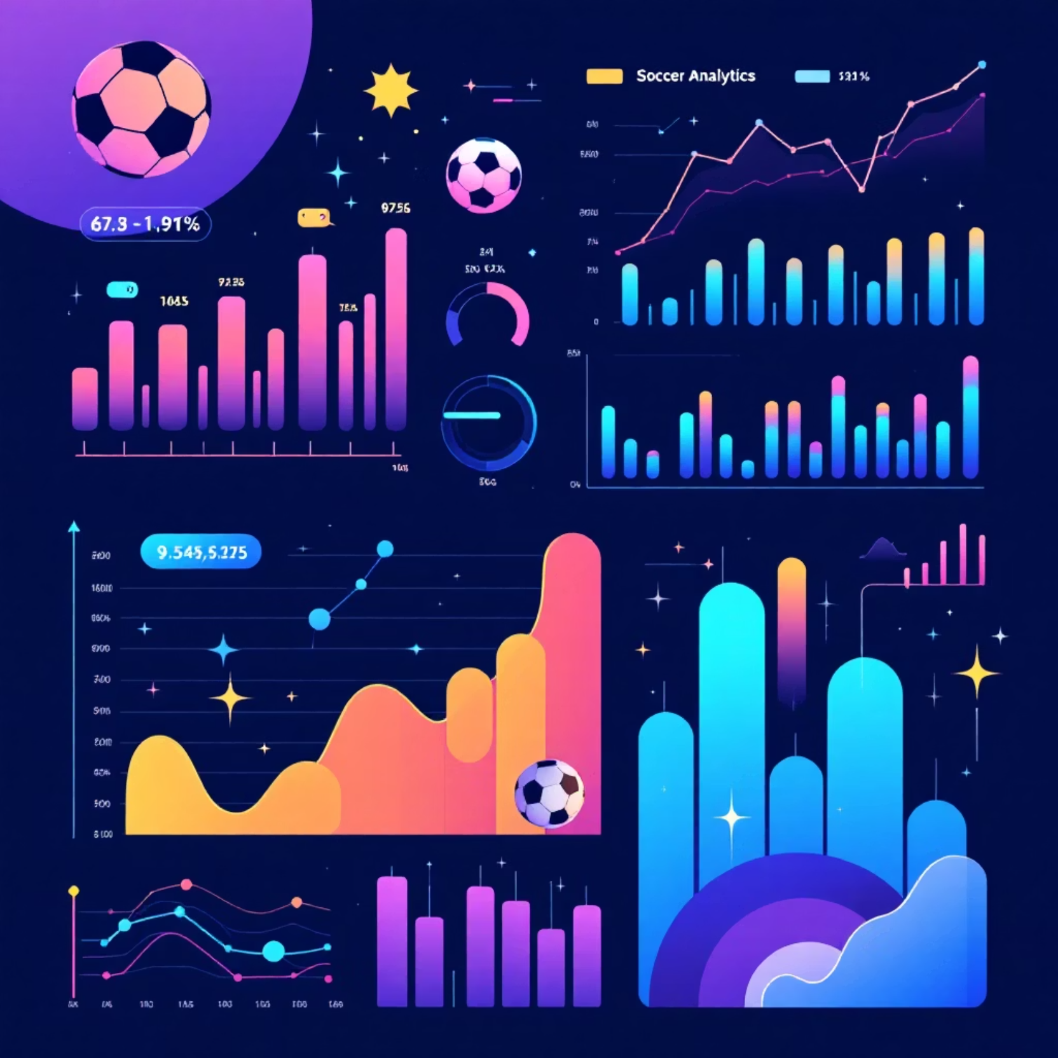
Problem Statement & Objectives
The Goal
Build a "live" estimator that accurately predicts a player's final goal tally based on mid-season performance statistics.
Model Type
Regression problem where the model learns to predict specific numbers (total goals) from input feature sets.

Slide 4




Feature Engineering Excellence
Player Attributes
Historical Benchmark
In-Season Metrics
Comprehensive player metadata including position, age, club affiliation, and individual characteristics
Previous season goal tallies provide crucial baseline performance context and trend analysis
Current appearances, assists, and the critical Goals_per_90 feature driving predictive accuracy

Slide 5



Model Architecture Deep Dive
Data Pipeline
XGBoost Engine
Scikit-learn pipeline ensures robust preprocessing and production-ready deployment
Industry-standard gradient boosting captures complex non-linear relationships in player performance

Slide 6
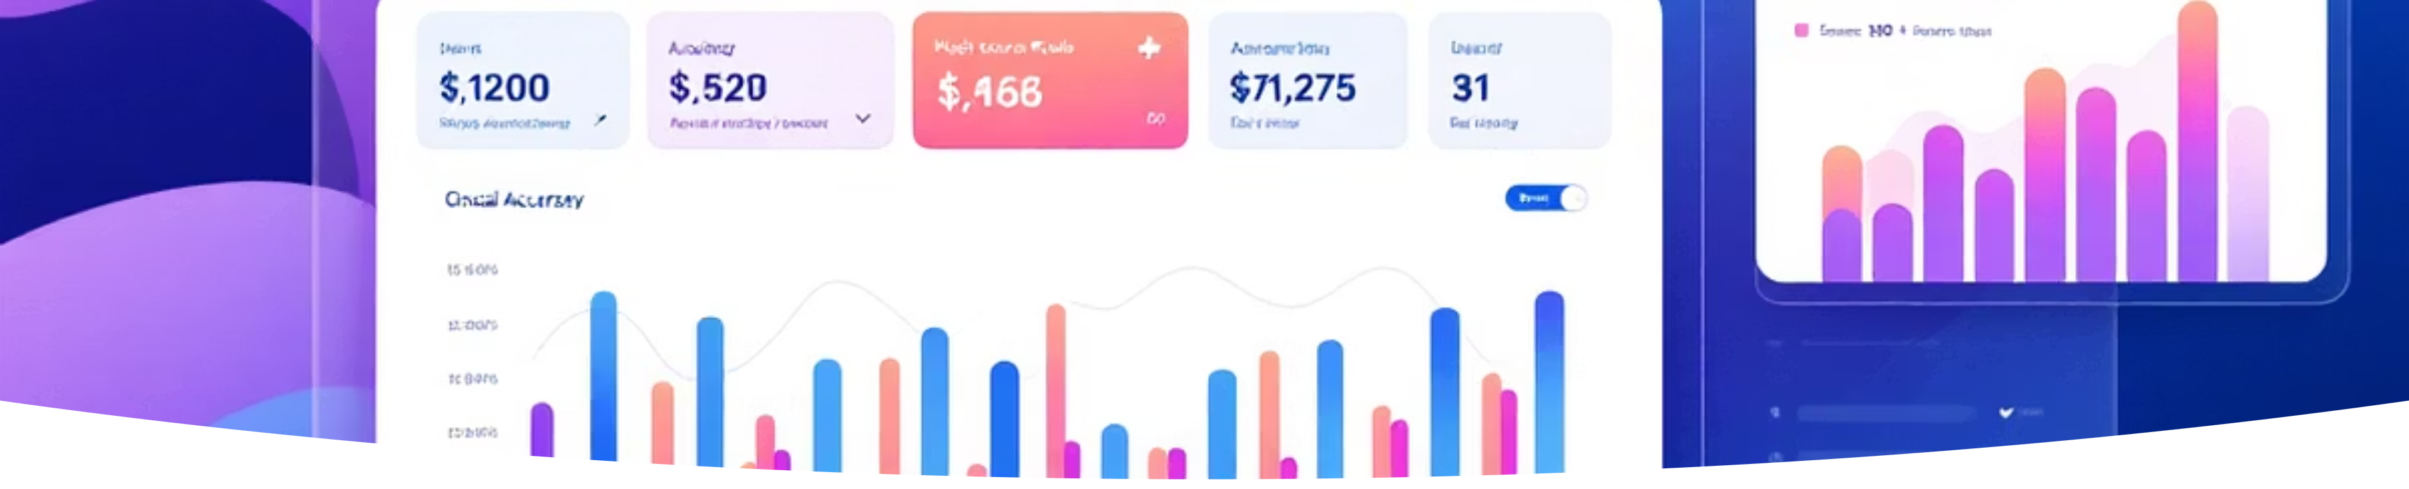
Champion Model Performance
92%
1.49
R-squared Score
RMSE (Goals)
Exceptional variance explanation demonstrates strong predictive capability across diverse player profiles
Ultra-precise estimates with average error of only 1.5 goals, exceeding industry benchmarks

Slide 7
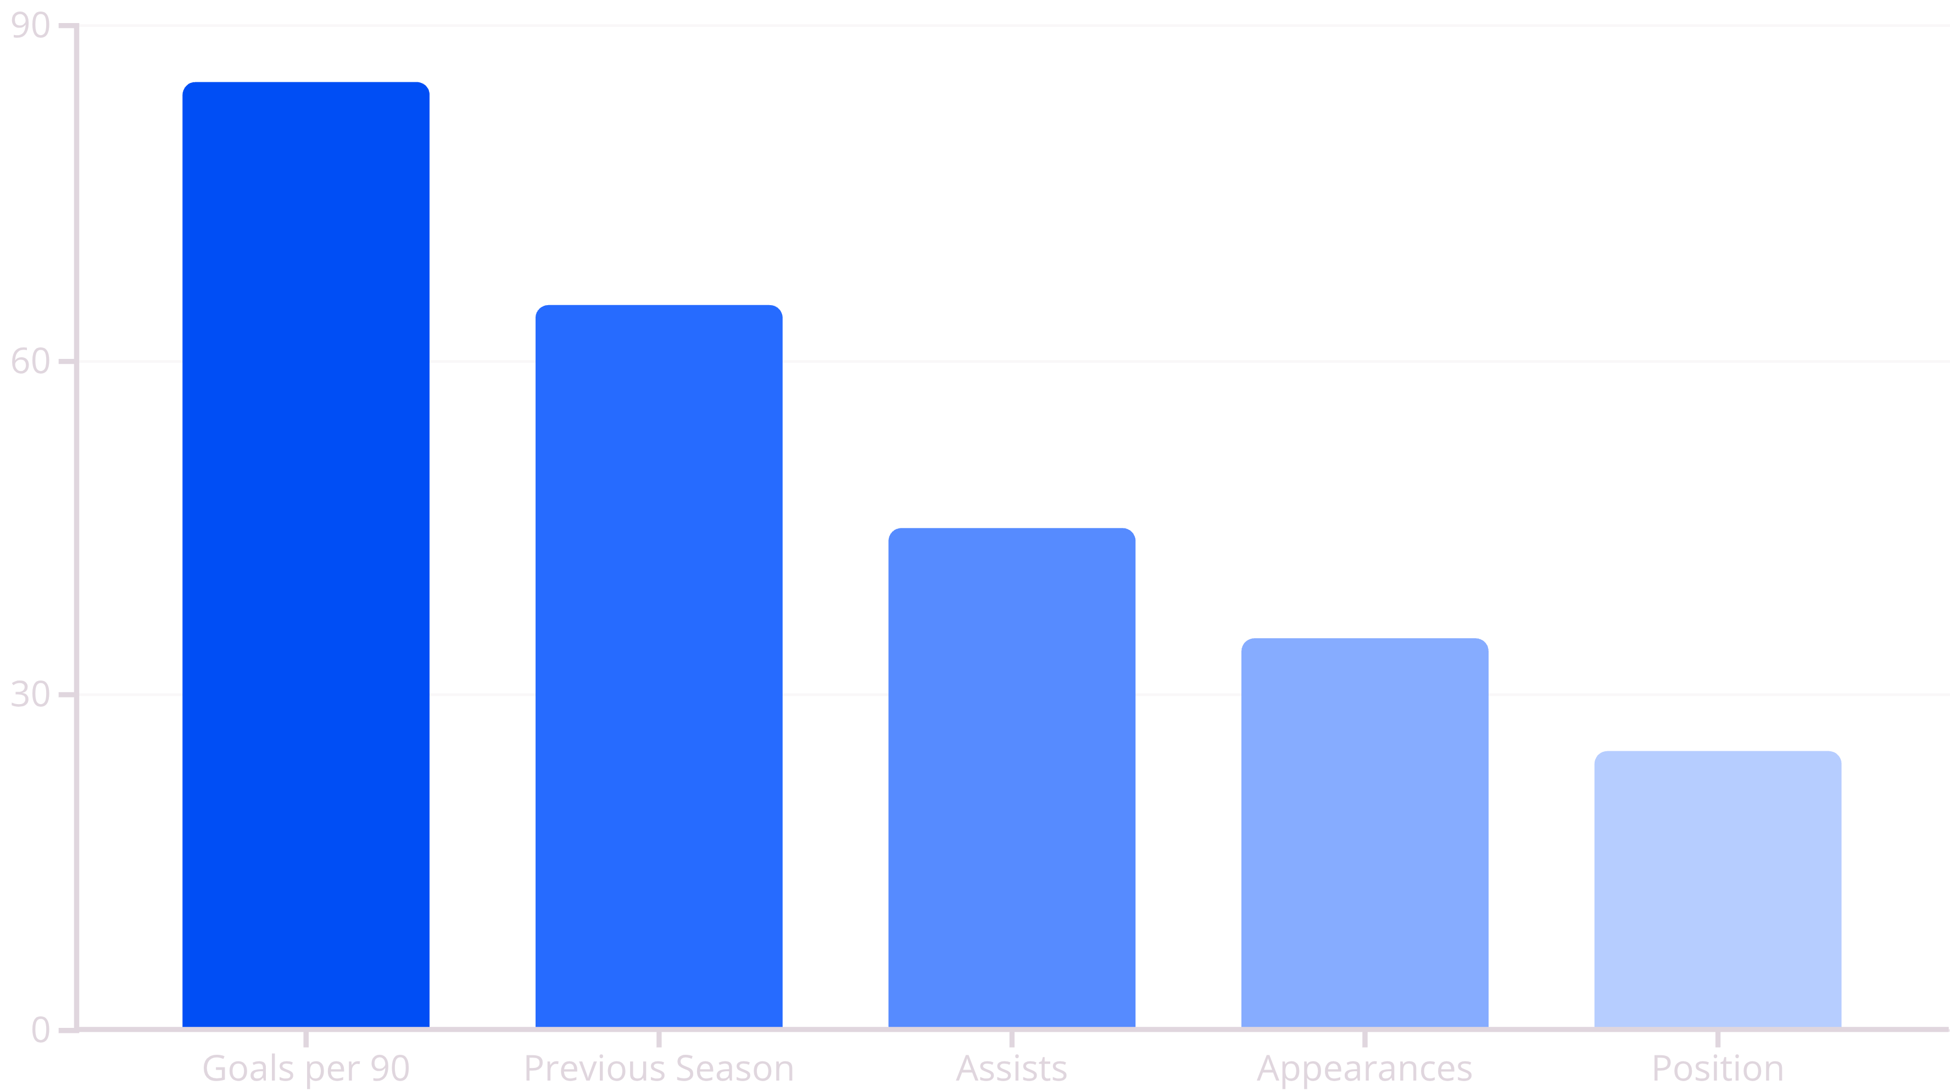
Key Feature Analysis
Goals_per_90 emerges as the dominant predictive feature, confirming the model's focus on current form over historical reputation.

Slide 8

Production Deployment
Dedicated UI Page
Interactive Input Form
Clean, intuitive "Top Goal Scorer Estimator" interface integrated into AI Football Suite
User-friendly forms for real-time stat input with intelligent validation and error handling
Comprehensive Guide
Built-in user documentation with Goals_per_90 calculation examples and feature explanations

Slide 9



Key Achievements & Impact
Technical Excellence
Feature Discovery
Full Integration
Delivered 92% R² XGBoost model exceeding performance targets with robust production pipeline
Identified Goals_per_90 as the most powerful predictor, revolutionizing in-season analysis approach
Successfully deployed within professional Streamlit application, creating comprehensive AI Football Suite

Slide 10

Thank You
Questions & Discussion
Arvind K N | B.Tech Computer Science, NIT Calicut | AI Intern at Infosys Springboard

